Slide 1
JMA Status Report
Yuki Honda
Senior Coordinator for Data Assimilation Systems
Numerical Prediction Division, Forecast Department
Japan Meteorological Agency

Slide 2
Contents
Current Status and Recent Progress of JMA’s NWP
Status of current and future satellite system
(prepared by Satellite Program Division)
Status Report of RTH Tokyo
(prepared by RTH focal point for Tokyo)

Slide 3
Current Status and Recent Progress of JMA’s NWP
Numerical Prediction Division
Forecast Department

Slide 4

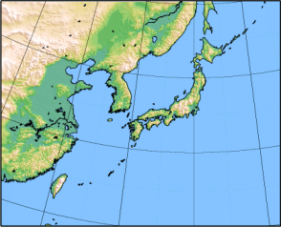
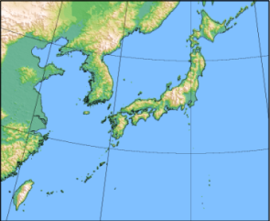
Current NWP models of NPD/JMA
 | In Operation |  |  |  | In Test Operation
 | Global Spectral Model GSM | Meso-Scale Model MSM | Local Forecast Model LFM | Global Ensemble GEPS | Meso-scale Ensemble MEPS
objectives | Short- and Medium-range forecast | Disaster reduction Aviation forecast | Aviation forecast Disaster reduction | One-week forecast Typhoon forecast | Uncertainty and probabilistic information of MSM
Forecast domain | Global | Japan and its surroundings (4080km x 3300km) | Japan and its surroundings (3160km x 2600km) | Global | Japan and its surroundings (4080km x 3300km)
Horizontal resolution | TL959(0.1875 deg) | 5km | 2km | TL479(0.375 deg) | 5km
Vertical levels / Top | 100 0.01 hPa | 48+2 21.8km | 58 20.2km | 100 0.01 hPa | 48+2 21.8km
Forecast Hours (Initial time) | 84 hours (00, 06, 18 UTC) 264 hours (12 UTC) | 39 hours (00, 03, 06, 09, 12, 15, 18, 21 UTC) | 9 hours (00-23 UTC hourly) | 264 h (00, 12 UTC) 132 h (06, 18 UTC)* 27 members | 39h 11 members
Initial Condition | Global Analysis (4D-Var) | Meso-scale Analysis (4D-Var) | Local Analysis (3D-Var) | Global Analysis with ensemble perturbations (SV, LETKF) | Meso-scale Analysis with ensemble perturbations (SV)
* when a TC of TS intensity or higher is present or expected in the RSMC Tokyo - Typhoon Center’s area of responsibility (0º–60ºN, 100ºE–180º).
Notes:
This table shows specifications of the models.

Slide 5
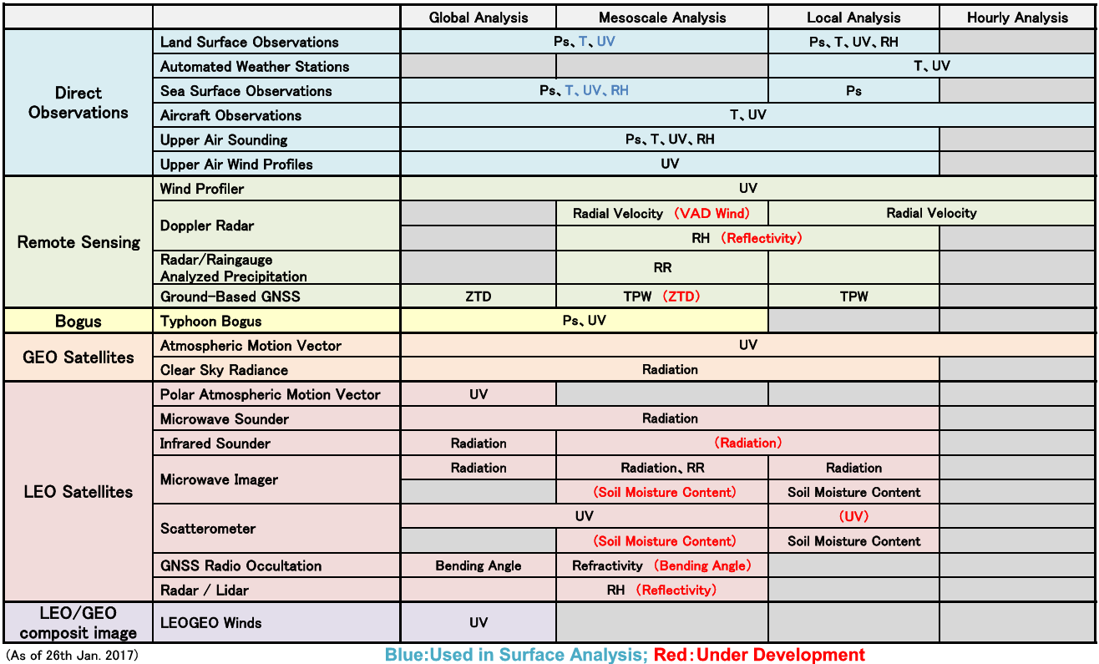
Assimilated Observations

Slide 6
Status of the assimilated satellite data
Satellite/Instrument |  | GA | MA | LA
1. MW Sounder | NOAA15,18,19,Metop-A,-B,Aqua/AMSU-A | Radiation | Radiation | Radiation
 | NOAA18,19,Metop-A,-B/MHS | Radiation | Radiation | Radiation
 | DMSP-F17,18/SSMIS | Radiation | [Radiation] | [Radiation]
 | S-NPP/ATMS | Radiation | [Radiation] | [Radiation]
 | Megha-Tropiques/SAPHIR | Radiation | [Radiation] | [Radiation]
2. IR Sounder | Aqua/AIRS | Radiation | [Radiation] | [Radiation]
 | Metop-A,B/IASI | Radiation | [Radiation] | [Radiation]
 | S-NPP/CrIS | Radiation | [Radiation] | [Radiation]
3. MW Imager | DMSP-F16,17,18/SSMIS | Radiation | Radiation, Rain Rate | Radiation
 | GCOM-W/AMSR2 | Radiation | Radiation, Rain Rate | Radiation
 | GPM-core/GMI | Radiation | Radiation | Radiation
4. VIS/IR Imager | Himawari-8 | CSR, AMV | CSR, AMV | CSR, AMV
 | GOES-13,15 | CSR, AMV | - | -
 | Meteosat-8,10 | CSR, AMV | - | -
 | NOAA15,18,19,Metop-A,-B/AVHRR | AMV | - | -
 | Aqua,Terra/MODIS | AMV | - | -
 | LEOGEO composite image | AMV | - | -
5. Scatterometer | Metop-A,-B/ASCAT | OSWV | OSWV | [OSWV]
6. RO | GRACE-A,-B/Blackjack | Bending Angle | Refractivity | (Under development)
 | Metop-A,-B/GRAS | Bending Angle | Refractivity
 | TerraSAR-X/IGOR | Bending Angle | Refractivity
 | TanDEM-X/IGOR | [Bending Angle] | Refractivity
 | COSMIC/IGOR | Bending Angle | Refractivity
7. Radar | GPM/DPR | - | Reflectivity | [Reflectivity]
8. Soil Moisture | GCOM-W/AMSR2 | - | [Soil Moisture] | Soil Moisture
 | Metop-A,-B/AVHRR | - | [Soil Moisture] | Soil Moisture
[ ]: Under Development
CSR: Clear Sky Radiance on water vapor channels, AMV: Atmospheric Motion Vector
OSWV: Ocean Surface Wind Vectors, RO: Radio Occultation

Slide 7
Updates SINCE the last meeting in 2016
GA: Global Analysis
MA: Meso-scale Analysis
LA: Local Analysis
Dec.2015: Metop/ASCAT Ocean Wind Vector for MA – by M. Moriya
Mar.2016: Himawari-8 AMV for GA, MA and LA – by K. Yamashita
  Dec. 2016: Revision of QC for GA
Mar. 2016: Himawari-8 CSR for GA and MA – by M. Kazumori
Mar. 2016: GPM-core/DPR for MA – by Y. Ikuta
Mar. 2016: GPM-core/GMI for GA and MA – by M. Kazumori
Mar. 2016: GNSS Radio Occultation for MA – by Y. Hirahara, H. Owada and M. Moriya

Slide 8
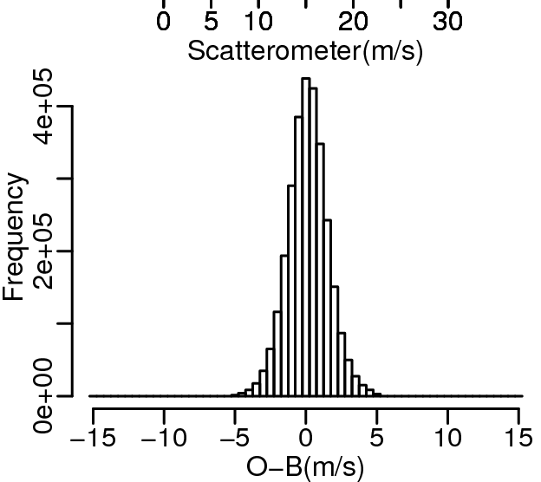
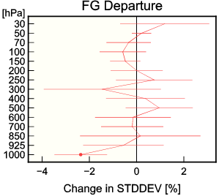
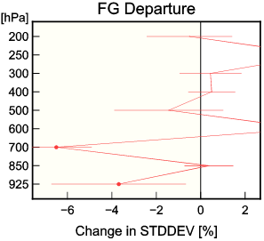
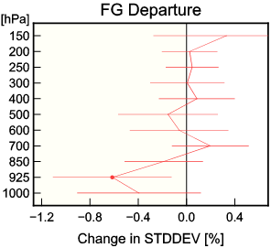
ASCAT Ocean Wind Vector (M)
First guess
  Wind fields are improved in particular at lower levels.
  Similar improvements were found for other elements such as MSLP and satellite brightness temperature.
Precipitation forecast (figures are omitted):
  ETS for heavy rain (40 mm/3 hours) in the summer experiment and moderate rain (10 and 30 mm/3 hours) in the winter experiment are improved.
  The other improvements such as low level wind speed and mean sea level pressure were also confirmed.
O–B freq. distribution
ME=0.14 [m/s]
STD=1.4 [m/s]
RAOB
AMV
Aircraft
better
worse

Slide 9
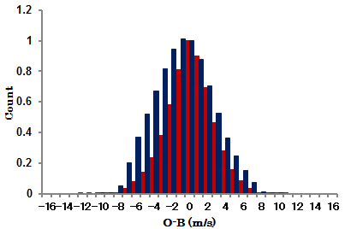
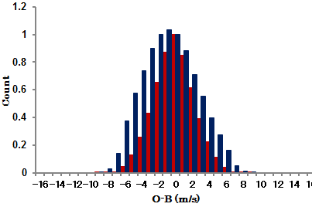
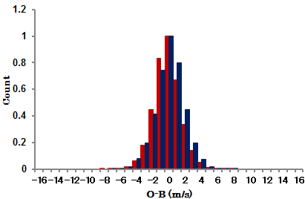
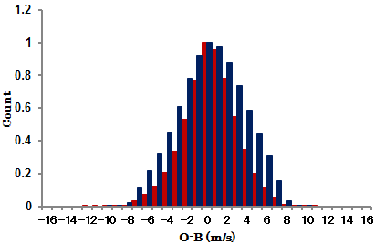
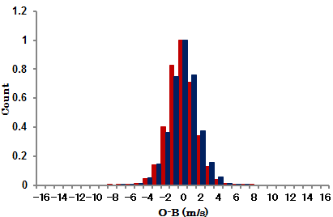

O-B normalized histograms of Himawari-8 AMVs in the Northern Hemisphere (poleward of 20N )
HL
ML
LL
NH-IR-HL
H8: ME STD
MT2：ME STD
NH-IR-ML
NH-IR-LL
IR
(B07
+B13)
H8 sample num.
MT2 sample
Num.
1238220
254619
-0.08 2.39
-0.76 3.15
2655491
1779867
-0.16 1.65
0.03 1.73
0.15 2.63
-0.77 3.22
1184701
398727
NH-WV-HL
NH-VS-LL
WV
(B08
+B09
+B10)
0.44 2.65
0.31 3.28
1884951
517113
1100327
502840
-0.09 1.56
0.02 1.60
VIS
(B03)
ME: Mean Error (unit m/s)
STD: Standard Deviation (unit m/s)
O-B: first guess departure
O-B normalized histograms for other regions has the same characteristics.
HL：≦400 hPa
ML：400～700 hPa
LL：≧700 hPa

Slide 10
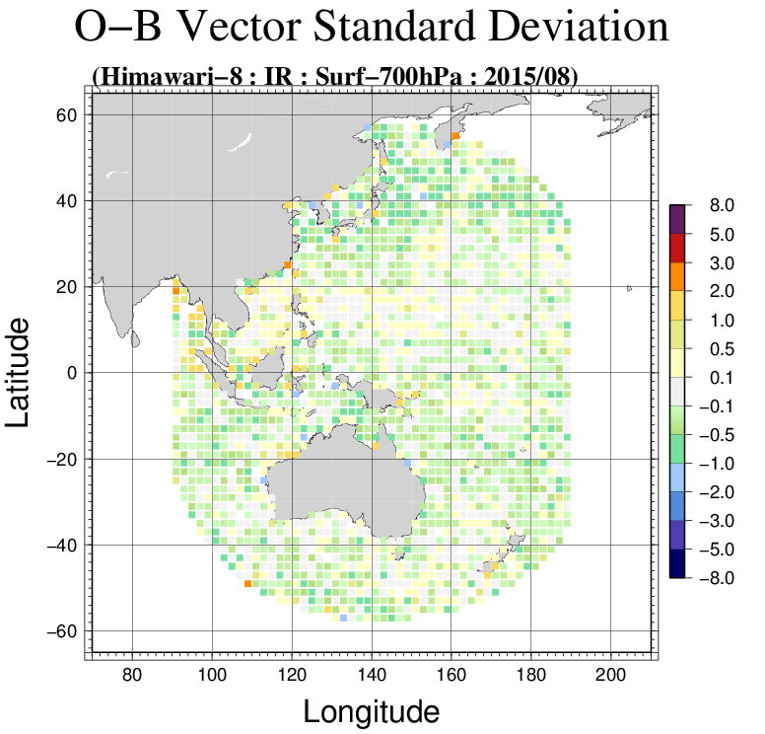
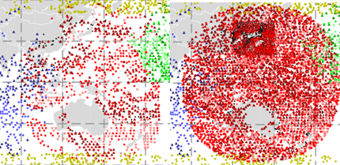
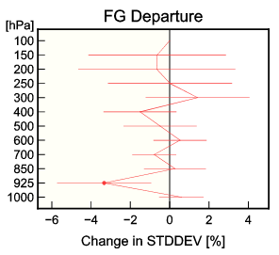
Data coverage and wind speed STD differences between TEST and CNTL on analyzed fields
●MTSAT
00 UTC 20 July 2015
●Himawari-8
Worse
CNTL
TEST
Better
●GOES-15 ●MET-7 ●LEOGEO
O-B wind speed STD differences (TEST-CNTL) below 700 hPa for summer 2015
Improved data coverage
Reduction of O-B wind speed differences over the Himawari-8 observation area ( especially around Japan )
Impact of revision of derived wind vector methods and introduced SPOB around Japan
Better
Worse
Normalized O-B wind speed STD differences against JMA’s wind profiler observations for summer 2015

Slide 11
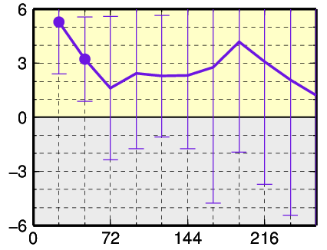
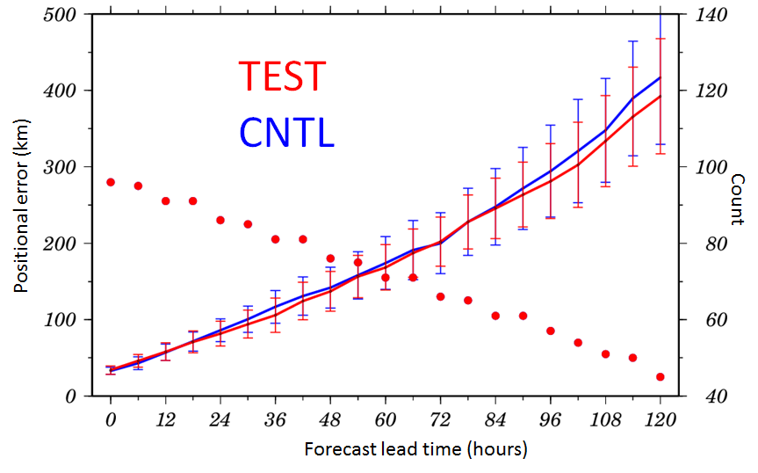
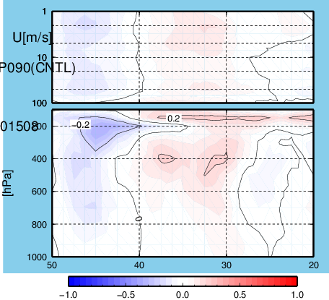
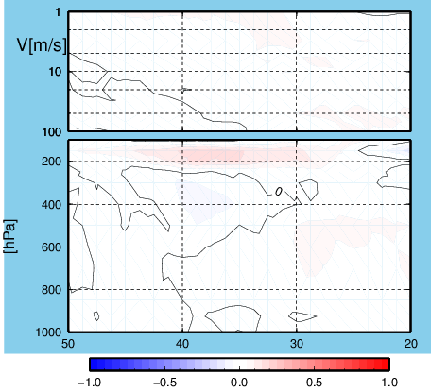
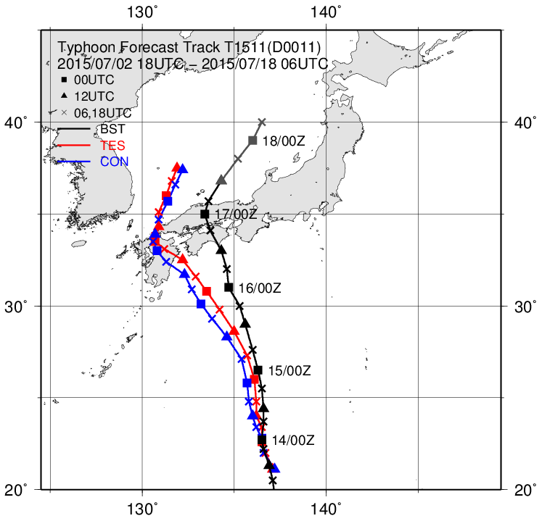
Results of OSE in summer 2015
Better
Worse
Slight
Forecast lead time (hours)
6% improved
Normalized RMSE differences around Japan between TEST and CNTL for 850 hPa wind vectors
Average of typhoon positional errors
Enhancement of jet stream
Enhancement of wind speed to the northward
Typhoon track forecast of
NANGKA (T1511) initialized at 12 UTC on 13 July 2015.
Improved
U
V
TEST
CNTL
BST
Analyzed field of U-component and V-component winds around Japan (Zonal mean meridional cross sections: TEST-CNTL)

Slide 12
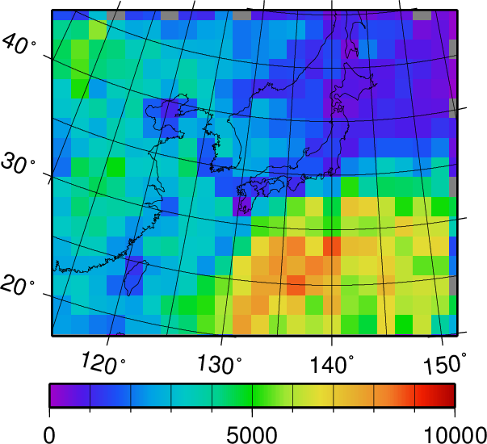
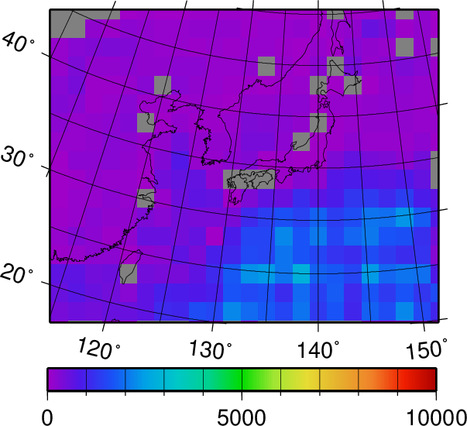
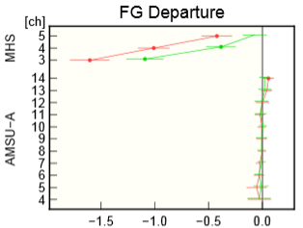
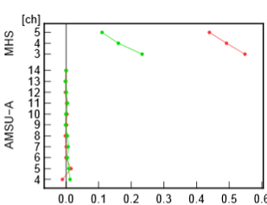
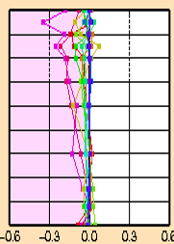
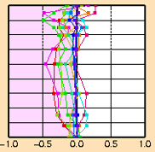
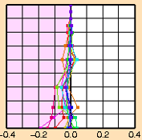
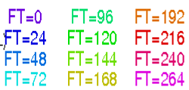
Himawari-8 CSR (G)
Assimilated CSR data numbers
Himawari8 Band 8
MTSAT-2 IR3
Data Usage:
Band 8 (Land, Ocean), Band 9 and 10 (only Ocean)
Averaged grid scale is changed from 64 km to 32km.
Quality Control:
Stop thinning in time, i.e. hourly data are assimilated.
Band 13 is used to detect the area of low clouds.
  B08:≥55%, B09:≥60%, B10:≥65%
Impacts on Analysis and Forecasts
Humidity fields in troposphere are improved.
Forecasts fields of T, U, Q over Japan are improved against RAOB and analysis.
Normalized changes in the STDV of OmB
(against Baseline (no Himawari8 nor MTSAT-2))
Red: Himawari8
Green: MTSAT-2
Data Num.
RMSE TEST-CTRL against RAOB over Japan
100hPa
U
T
Q
500hPa
1000hPa

Slide 13
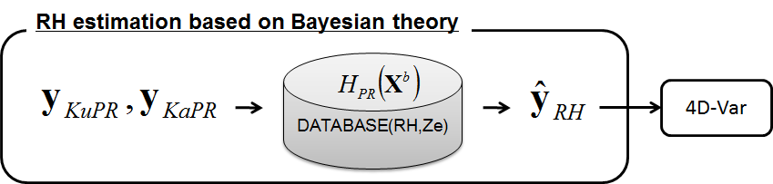
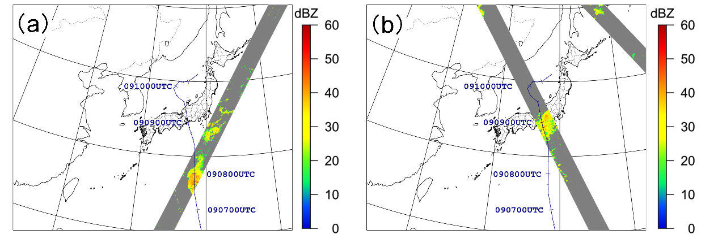
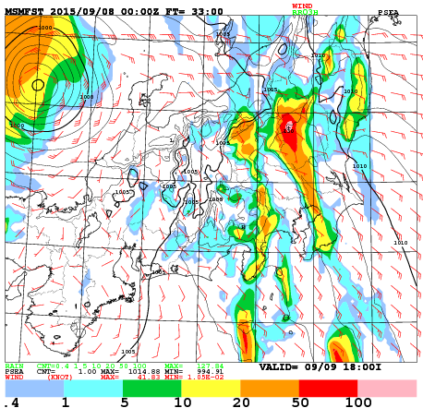
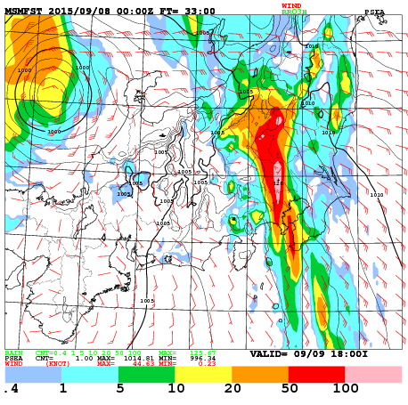
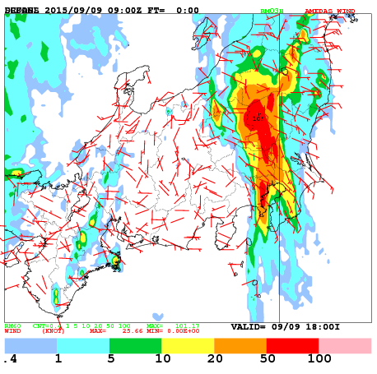
GPM/DPR (M)
JMA is the first NWP center to use space-borne radar data operationally.
The same 1D+4DVar method for ground-based radar data assimilation is used.
  Both KuPR and KaPR are used.
  Liquid phase data are only used.
Path of GPM-core and simulated KuPR
7 Sep. 2015, 15UTC
8 Sep. 2015, 00UTC
CONTROL w/o DPR
TEST with DPR
OBSERVATION
Lead time: 33-hour Initial time: 2015-09-08 00UTC

Slide 14
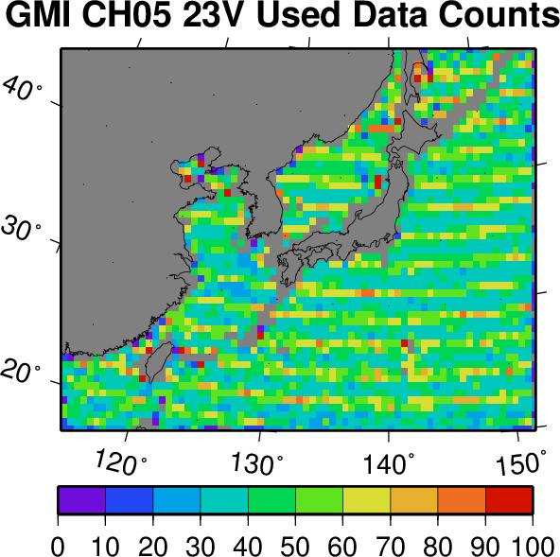
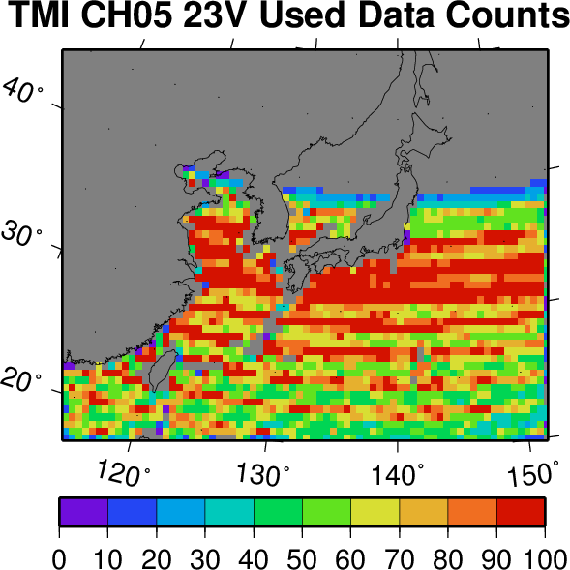
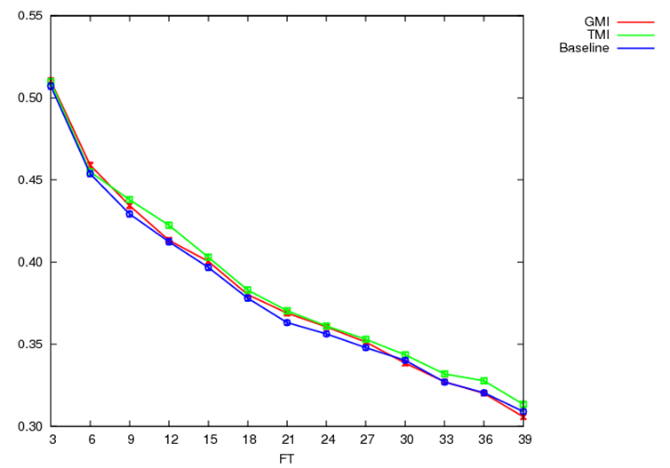
GPM/GMI(M)
TMI | GMI
10.65V | 10.65V
10.65H | 10.65H
19.35V | 18.7V
19.35H | 18.7H
21.3V | 23.8V
37V | 36.64V
37H | 36.64H
85.5V | 89V
85.5H | 89H
 | 166V
 | 166H
 | 183+3V
 | 183+7V
GMI is the successor of TMI.
In the pre-operation test for July 2014, GMI assimilation were compared to the TMI assimilation and baseline (w/o GMI,TMI)
While GMI assimilation showed positive impact on precipitation forecast in its OSE with JMA’s Meso Scale Model, TMI assimilation showed the better impact.
Because of the observation frequency difference, It was inferred “The more frequent observation provides the better forecast”
Used data counts
Thread Score 1mm/hr
GMI
TMI
GMI ---
TMI ---
Baseline ---
Central frequency [GHz]
Red:
for assimilation
Forecast hour

Slide 15
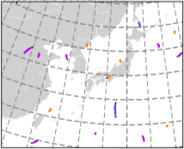
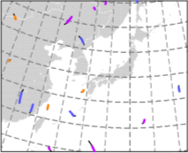
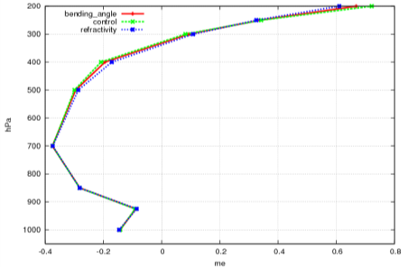
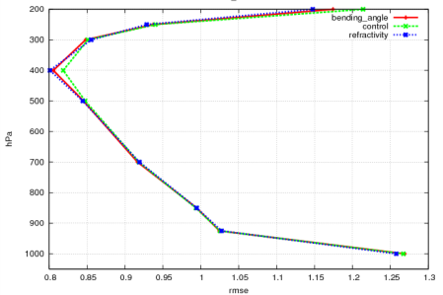
GNSS Radio Occultation (M)
Data Coverage on 9 Sep. 2015
Improvement by using refractivity is slightly better than using bending angle.
This result suggests that the upper layer information of the model is insufficient for the assimilation of bending angle due to the limited model-top height (22km).
03UTC
15UTC
COSMIC
GRACE-B
TerraSAR-X
Metop-A
Metop-B
TanDEM-X
Results: Analysis fitting to observations
Statics of temperature in compared with Radio-sonde observation
(hPa)
(hPa)
Period: 1 Jul, 2014 - 24 Aug, 2014
200
200
400
NO RO
400
NO RO
REFRAC
REFRAC
600
BANGLE
600
BANGLE
800
ME
800
RMSE
Better
1000
1000
-0.4
-0.2
0
0.2
0.4
0.6
(K)
0.8
0.9
1.0
1.1
1.2
(K)

Slide 16
Updates SINCE the last meeting in 2017
GA: Global Analysis
MA: Meso-scale Analysis
LA: Local Analysis
Jan. 2017: Satellite Radiance Data for LA – by Y. Ikuta
  NOAA,Metop/AMSU-A; NOAA, Metop/MHS; Aqua/AMSU-A; GCOM-W/AMSR2; DMSP/SSMIS; GPM-core/GMI; Himawari-8/AHI
Jan. 2017: Satellite Soil Moisture Data for LA – by Y. Ikuta
  GCOM-W/AMSR2, Metop/ASCAT
Mar. 2017: Suomi-NPP/ATMS for GA – Y. Hirahara, T. Egawa and M. Kazumori
Mar. 2017: Suomi-NPP/CrIS for GA – M. Kamekawa and M. Kazumori
Mar. 2017: DMSP-F17,18/SSMIS(183GHz) for GA – Y. Murakami and M. Kazumori

Slide 17
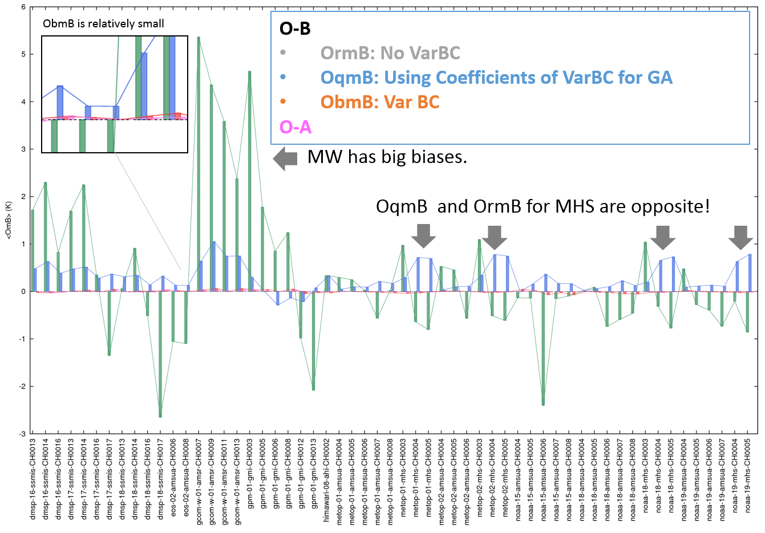
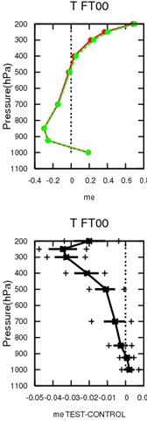
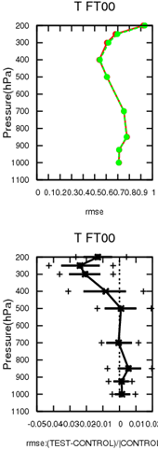
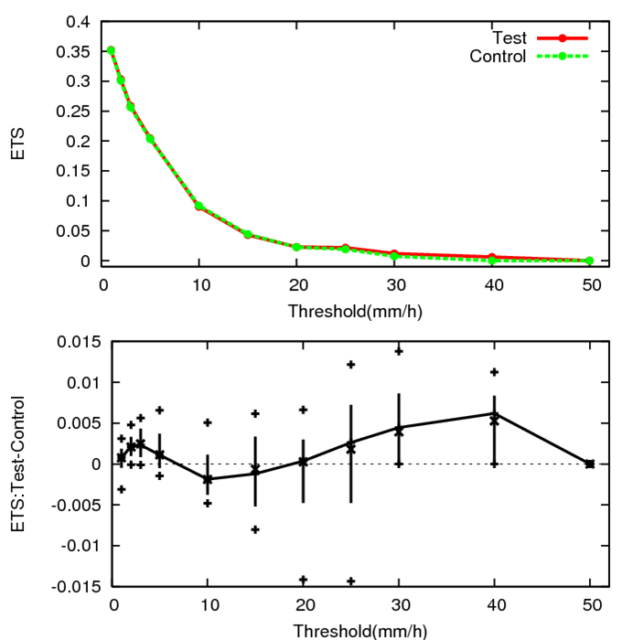
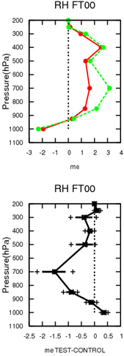
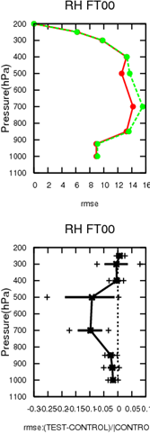
Sat. Rad. Data (L)
Assimilated satellite radiance data
NOAA,Metop/AMSU-A; NOAA, Metop/MHS; Aqua/AMSU-A; GCOM-W/AMSR2; DMSP/SSMIS; GPM-core/GMI; Himawari-8/AHI
Introduction of Variational Bias Correction (VarBC)
Predictor: Const, Scan angle, SST
SUMMER
T: ME RMSE
WINTER
ETS
RH: ME RMSE
17

Slide 18
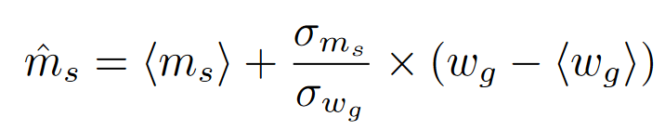
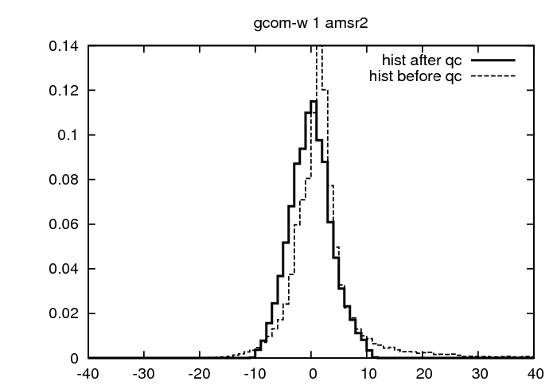
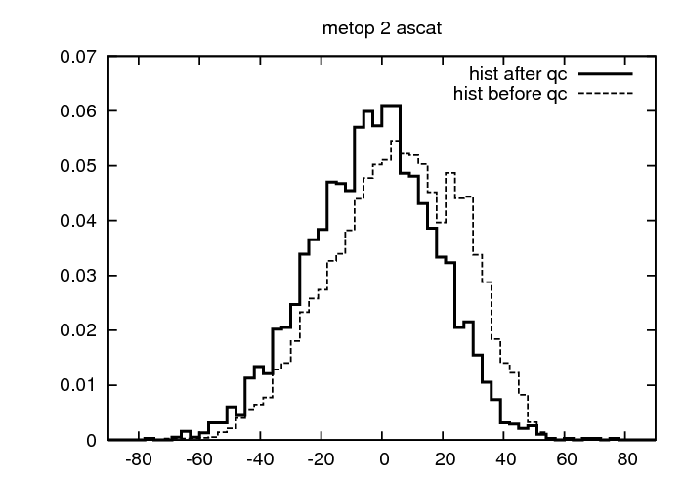
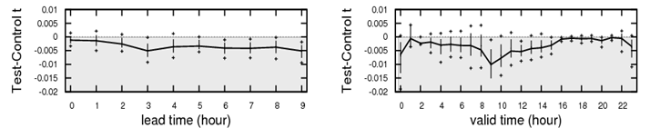
Soil Moisture Products of
GCOM-W/AMSR2, Metop/ASCAT (L)
Asuca-Var: DA for Local Anlysis
  Analysis variables:
Observation Operator: CDF matching
Quality Control
  Elimination of the Data in Precipitation Area, Accumulated Snow Area, Forest Area, Artificial Construction Area, Water Surface Area (Ocean, Lake, River etc.)
  Gross error check
  Bias correction – predictor (predictor: const)
Impacts on Analysis and Forecasts
  Improvement of ETS around 10mm/h in Summer
  Improvement of ETS for 15mm/h in Winter
  RMSE of surface temperature is improved during daytime
  Negative bias of humidity near surface is exaggerated.
ground and skin temperature
soil volumetric water content
AMSR2
ASCAT

Slide 19




Suomi-NPP/ATMS (G)
OFF
ON
Data Usage:
- Only tropospheric CHs (6–9, 18–22)
- Thinning distance is 250km, independently from AMSU-A and MHS.
Quality Control of ATMS data:
- Noise filter is applied at decoding.
- QC is same to that for AMSU-A and MHS
Impact on Analysis
- ATMS assimilation improves water vapor and temperature fields in FG fields.
Impact on Forecasts
- ATMS assimilation improved forecast in mid- and upper-troposphere, especially in the Southern Hemisphere.
- It also brought slight improvement of tropical cyclone track predictions.
AAP FFT-based Noise Filtering (CH8 OmB)
SSMIS
RAOB-T
GNSS-RO
AMSR2
GMI
Normalized changes in the STDV of OmB in Summer
FT=24
FT=48
FT=72
19
Zonal mean of RMSE(CTRL) – RMSE(TEST) of geopotential height in August 2015

Slide 20





Suomi-NPP/CrIS (G)
MW Sounder
GNSS-RO
Usage: CHs (around 15µm) sensitive
to T --- (land) 25CH, (Ocean) 27CH
Observation Error of HSS
Statics period
2015.6-8 summer
2015.12-2016.02 winter
AIRS
IASI
Obs error (K)
CrIS
Wave Number(cm-1)
Obs error of CrIS is smaller than that of IASI and AIRSl
CrIS assimilation improved the fitting of FG to other obs. such as AMSU-A and GNSS-RO.
It also improved geopotential height forecast in Southern Hemisphere.
RMSE is against own analysis

Slide 21







DMSP/SSMIS(183GHz)(G)
OmB of DMSP-F17/CH9
Data Usage: (SSMIS Imager CHs are already used.)
Clear-sky data of SSMIS 3CHs (CH 9,10, 11) around 183GHz of DMSP-F17,18
Quality Control of SSMIS(183GHz) data:
Cloud detection algorithm w/o 157GHz CH
  QCs for MHS uses 157GHz CH to identify cloudy area.
  Clouds classified into Cloud Liquid Particle, Snow Crystal and Ice Crystal are removed.
  Impacts on Analysis and Forecasts
Improved fits in FG departure of water vapor field. Mean analysis field is almost unchanged.
Positive impact for the prediction of Z and T at Southern Hemisphere.
Before QCs
After QCs
Ratio (CNTL-TEST)/CNTL
Normalized changes in the STDV of OmB
FT=48
FT=72
FT=96
Summer
Winter

Slide 22


JMA report on the status of current and future satellite system
Japan Meteorological Agency
GODEX-NWP first Session
16-19 May 2017

Slide 23








Overview – Planning of JMA satellite systems
(Himawari-series)
GMS (Geostationary Meteorological Satellite)
GMS
GMS-2
GMS-3
GMS-4
GMS-5
(GOES-9)
(Himawari)
(Himawari-2)
(Himawari-3)
(Himawari-4)
(Himawari-5)
Back-up operation of
GMS-5 with GOES-9 by
NOAA/NESDIS
from May 22, 2003
to June 28, 2005
ⒸNASDA
ⒸNASDA
ⒸNASDA
ⒸNASDA
ⒸNASDA
Launched in
Jul 1977
Aug 1981
Aug 1984
Sep 1989
Mar 1995
MTSAT (Multi-functional Transport SATellite )
Satellite | Observation period
GMS | 1978 – 1981
GMS-2 | 1981 – 1984
GMS-3 | 1984 – 1989
GMS-4 | 1989 – 1995
GMS-5 | 1995 – 2003
GOES-9 | 2003 – 2005
MTSAT-1R | 2005 – 2010
MTSAT-2 | 2010 – 2015
Himawari-8 | 2015 – 2022
Himawari-9 | 2022 – 2029
MTSAT-1R
MTSAT-2
(Himawari-6)
(Himawari-7)
Himawari-8
Himawari-9
Himawari
Oct 2014
2016
ⒸSS/L
ⒸMELCO
Launched in
Feb 2005
Feb 2006

Slide 24

Himawari-8/9 Mission Schedule
Himawari-8 has stably been operational since July 2015.
Himawari-9, which was launched in November 2016, has started in-orbit standby since 10 March 2017.
  MTSAT-2’s meteorological mission terminated.
Himawari-9 will continue in-orbit standby until FY 2022, then will be operational until FY 2029 as a successor to Himawari-8.
Japanese
Fiscal Year

Slide 25

First Image by Himawari-9
02:40 UTC on 24 January 2017

Slide 26




Himawari-8/9 Satellite
H-IIA31
(Photo: Mitsubishi Heavy Industries Group)
Himawari-9
(Photo: Mitsubishi Electric Corporation)

Slide 27
Advanced Himawari Imager (AHI)
on Himawari-8/9 Satellite
AHI : new generation GEO imager
3 VIS, 3 NIR and 10 IR bands
Full disk observing cycle: 10 min., rapid scanning within 2.5 min. / 30 sec. intervals
*
* Nominal value

Slide 28

Mission Overview

Slide 29











Himawari-8/9 Data Dissemination
Communication Satellite (CS)
Himawari-8/9
HimawariCast
service
raw data
C-band antenna
HRIT files,
LRIT files,
SATAID files
LNB
CS Operator
HSD files,
NefCDF files,
PNG files
DVB-S2 receiver
PC & software
JMA
HimawariCloud service
NMHSs
Users

Slide 30
HimawariCloud service
HimawariCloud service started distributing Himawari-8 in-orbit-test imagery in April 2015.
Full-disk imagery is available within 8 minutes on the HimawariCloud server.
In November 2015, HRIT data distribution started(same as the ones disseminated via HimawariCast).
Upon receiving application forms, JMA is providing HimawariCloud 23 (as of Jan. 2017) accounts for NMHSs in the East Asia and Western Pacific regions.
Observation type | Format | Notes
Full disk (10-minute intervals) | Himawari Standard Data (HSD) PNG | HSD: 16 bands (full resolution) PNG: True-color composite (1 km) HRIT files (HSD)
Target area (2.5-minute intervals) | HSD NetCDF PNG | HSD: 16 bands (full resolution) NetCDF: 16 bands (latitude/longitude grid) PNG: True-color composite (1 km)

Slide 31

HimawariCast service
HimawariCast service started disseminating Himawari-8 imagery in July 2015.
Communication satellite: JCSAT-2A (154 degrees East)
was followed by JCSAT-2B in
July 2016
Data type | Format | Notes
Himawari imagery (full disk) | HRIT files LRIT files Compatible with the MTSAT HRIT/LRIT services | Interval: 10 minutes HRIT: 14 bands (VIS: 1 km, IR: 4 km) LRIT: 4 bands (VIS, IR1, IR3, IR4: 5 km)
NWP products In-situ observations ASCAT ocean surface wind | SATAID format | Superimposed onto satellite imagery by SATAID software

Slide 32



Himawari-8/9 Mission Consistency
Himawari-8 and -9 have:
  a very close orbital position;
    separated by only 0.1 deg. around 140.7 degE.
  very similar spectral response.
    equipped with the Advanced Himawari Imager (AHI)
JMA ensures consistent and contiguous observation over 14 years by those two satellites.
AHI-8 and AHI-9 spectral response for VIS, NIR and IR spectral regions

Slide 33
Contingency Plan
In case of Himawari-8’s anomaly, back-up observation by Himawari-9 is performed.
Himawari-9’s data dissemination via HimawariCloud/Cast quickly starts after the anomaly;
  Band01-03 (VIS) : 4 hours after
  Band04-16(NIR/IR): 24 hours after
Basically, Himawari-8’s observation is also cancelled due to a scheduled satellite maintenance for several hours once a year.
In such a case, Himawari-9’s data are disseminated.

Slide 34

Consistency of Himawari-8 and -9
Himawari-8
Himawari-9
Band13(10.4um), 2 February 2017

Slide 35
Status Report of RTH Tokyo
RTH focal point for Tokyo
Presented by Yuki HONDA
(Numerical Prediction Division of JMA)
First Meeting on Global Operational Data Exchange
for NWP (GODEX-NWP)
(Lannion, France; 16 to 19 May 2017)

Slide 36
GTS Connections (Apr. 2017)
Toulouse
Exeter
Offenbach
50Mbps
Beijing
20Mbps
16Mbps
50Mbps
December
2015
Melbourne
RMDCN
WIS Core-net. (Interoute)
4Mbps
4Mbps
Seoul
50Mbps
Migrated from leased line to WIS core-network
Bandwidth:
128Kbps to 4Mbps
Washington
4Mbps
New Delhi
10Mbps X 2
MPLS network
(NTT)
Tokyo
128Kbps
64kbps
2Mbps
Khabarovsk
Bangkok
1Mbps
64Kbps
Doha
Hong Kong
Manila
2Mbps
April 2017

Slide 37

Daily Volume (WIS core-network)
GISC Tokyo connects to GISCs over the WIS core-network(RMDCN)
  Washington
  Melbourne
  Exeter
  Beijing
  Seoul
  New Delhi
  Toulouse
  Offenbach

Slide 38

Daily Volume (NTT MPLS network)
GISC Tokyo connects to SE-ASIA counties over the NTT MPLS network
  Hong Kong
  Bangkok
  Manila

Slide 39
Satellite Data Exchange (1)
APSDEU14 to GODEX-NWP1
Metop-B/ATOVS (received at Syowa Station, Antarctica)
3 August 2016
    To Beijing, Exeter, Hong Kong, Melbourne, New Delhi, Seoul, Washington, Toulouse, Offenbach and Doha
  EUMETSAT SEVRI radiance data
  7 September 2016:
    To New Delhi
  COSMIC data
  16 November 2016
  To Hong Kong

Slide 40
Satellite Data Exchange (2)
APSDEU14 to GODEX-NWP1
Meteosat-8 (AMV, CSR, ASR, etc.)
November 2016
Indian Ocean Data Coverage (IODC) Meteosat-8 data from Offenbach
To Seoul
Metop-A,B/IASI (received at Jincheon Station)
February 2017
Metop IASI data from Seoul
To Beijing, Exeter, Hong Kong, Melbourne, New Delhi, Washington, Toulouse, Offenbach and Doha

Slide 41

AP-RARS connectivity 2017
Papeete
Toulouse
Hong Kong
Singapore
Jincheon
Asia-pacific regional RARS center
Fiji
Melbourne
Tokyo
Beijing
Guangzhou
Urumuqi
Crib Point1
Darwin
Perth
Townsville
Casey
Davis
Kiyose
Syowa
Exeter
Washington
Kelburn
Maupuia
New Delhi
Chennai
Guwahati

Slide 42
Thank you for your attention

Slide 43
Thank you

Slide 44
Thank you

